Slide 1
Decoding Grasp Force in the M1 During Object Transportation
Zihao Chen, Hatsopoulos Lab
Metcalf Research Program 2024
8.13.2024

Slide 2
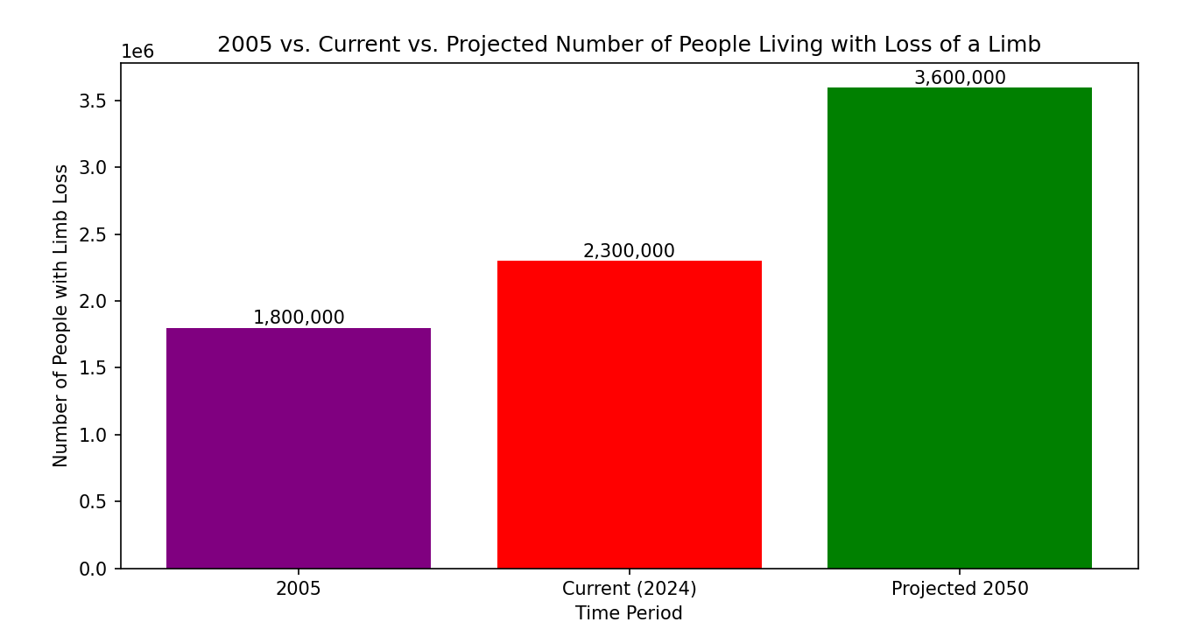
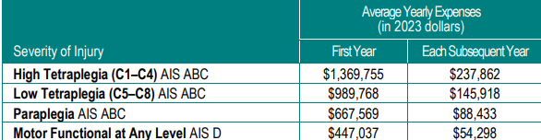
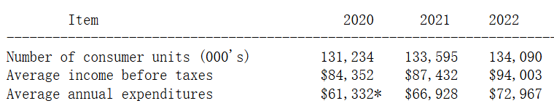
Movement disability becomes a more important social issue
Limb Loss
Spinal Cord Injury
Average expenditures for all consumer units in 2022
White et al., Amputee Coalition, 2024
Ziegler-Graham et al., Archives of Physical Medicine and Rehabilitation, 2008
National Spinal Cord Injury Statistical Center, 2024
U.S. Bureau of Labor Statistics, 2022
Notes:
Let’s first look at some statistics here. In 2005, more than 1.8 million people suffered from limb loss in the United States. The number has since grown to 2.3 million this year based on a new report. It is projected by the author that by the year 2050, the number will become 3.6 million, meaning that for each 100 people, there is 1 that suffers from limb loss.
Although the population suffering from spinal cord injury is much smaller, they have to deal with the greatly increased living cost as a result of the injury. We can see here that the annual year expense can even be several times higher than the average annual expense of a household with multiple people!

Slide 3
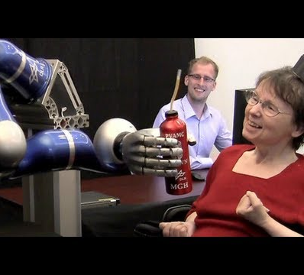
Brain-Computer Interfaces (BCIs) may promise prosthetics that can provide better precision and more possible actions
Notes:
To deal with this issue, better prosthetics are needed. Recent development of brain-computer interfaces (BCIs), which interpret motor signals recorded from the brain and facilitate control of body parts with external (robotic) devices, allow patients to control prosthetics with motor signals and thus can provide better precision and more possible actions. As a result, patients can be more independent, which both increases life satisfaction and lowers expenses.

Slide 4
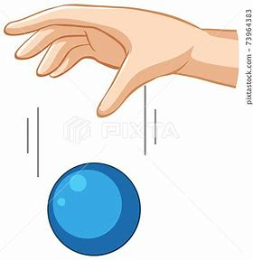
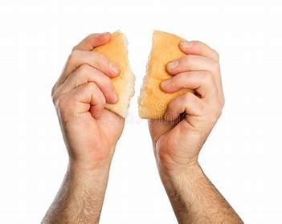
Grasp force decoding is a new significant realms for neural prosthetics
Force too small: drop the object
Force too large: break the object
Notes:
Previous prosthetics focused on decoding kinematics, or positions and velocities. However, grasp force decoding is becoming a new significant realm. If patients are not able to apply the expected grasp force with the robotic arm, when they hold an object in hand using the prosthetics, even if they have the exact kinematics, they may either drop the object or break it by overapplying force.
And our research is dedicated to this realm.

Slide 5
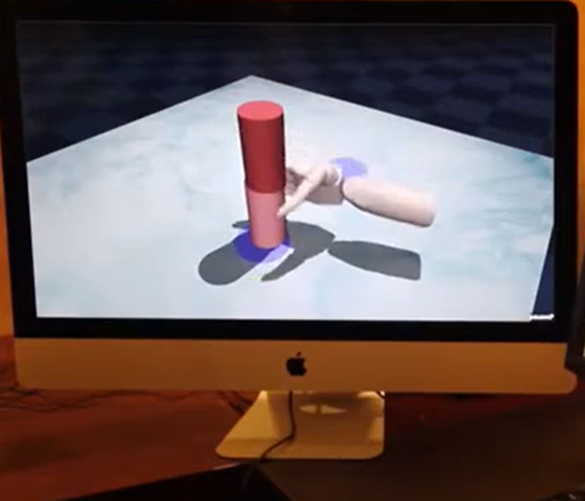
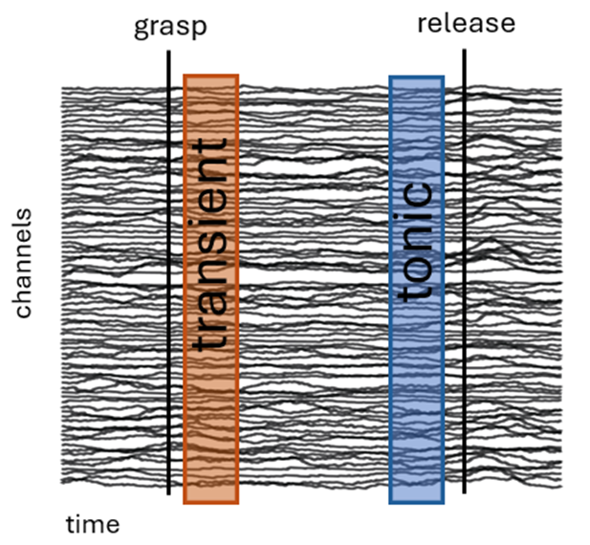
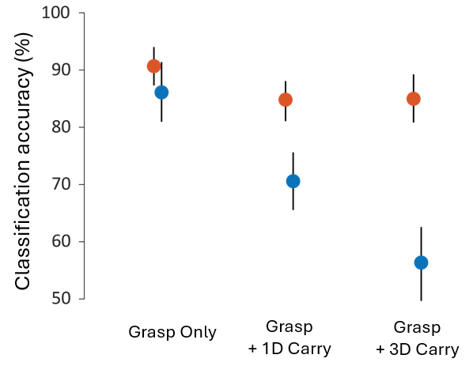
Grasp force information disappears from the M1 during object transportation tasks
Decoded grasp force information in the M1
Chance level
Brian Dekleva
Notes:
What motivates our research is that previous research indicates that the grasp force information is lost during object transportation. In the experiment, subjects are asked to imagine grasping a virtual object using a virtual arm on the screen and perform object transportation tasks, as shown here. In the transient phase, the virtual arm grasps the object while the arm was still. Then, in the tonic phase, the virtual arm either stays still or makes 1 dimensional or 3 dimensional object transportation. After this phase, the object is released.
We can see that the decoded grasp force information exists in the S1 when the participants grasp the object and stay still. However, as the dimension of object transportation increases, that information gradually disappears. For three-dimensional movement, the accuracy is already near the chance level.

Slide 6
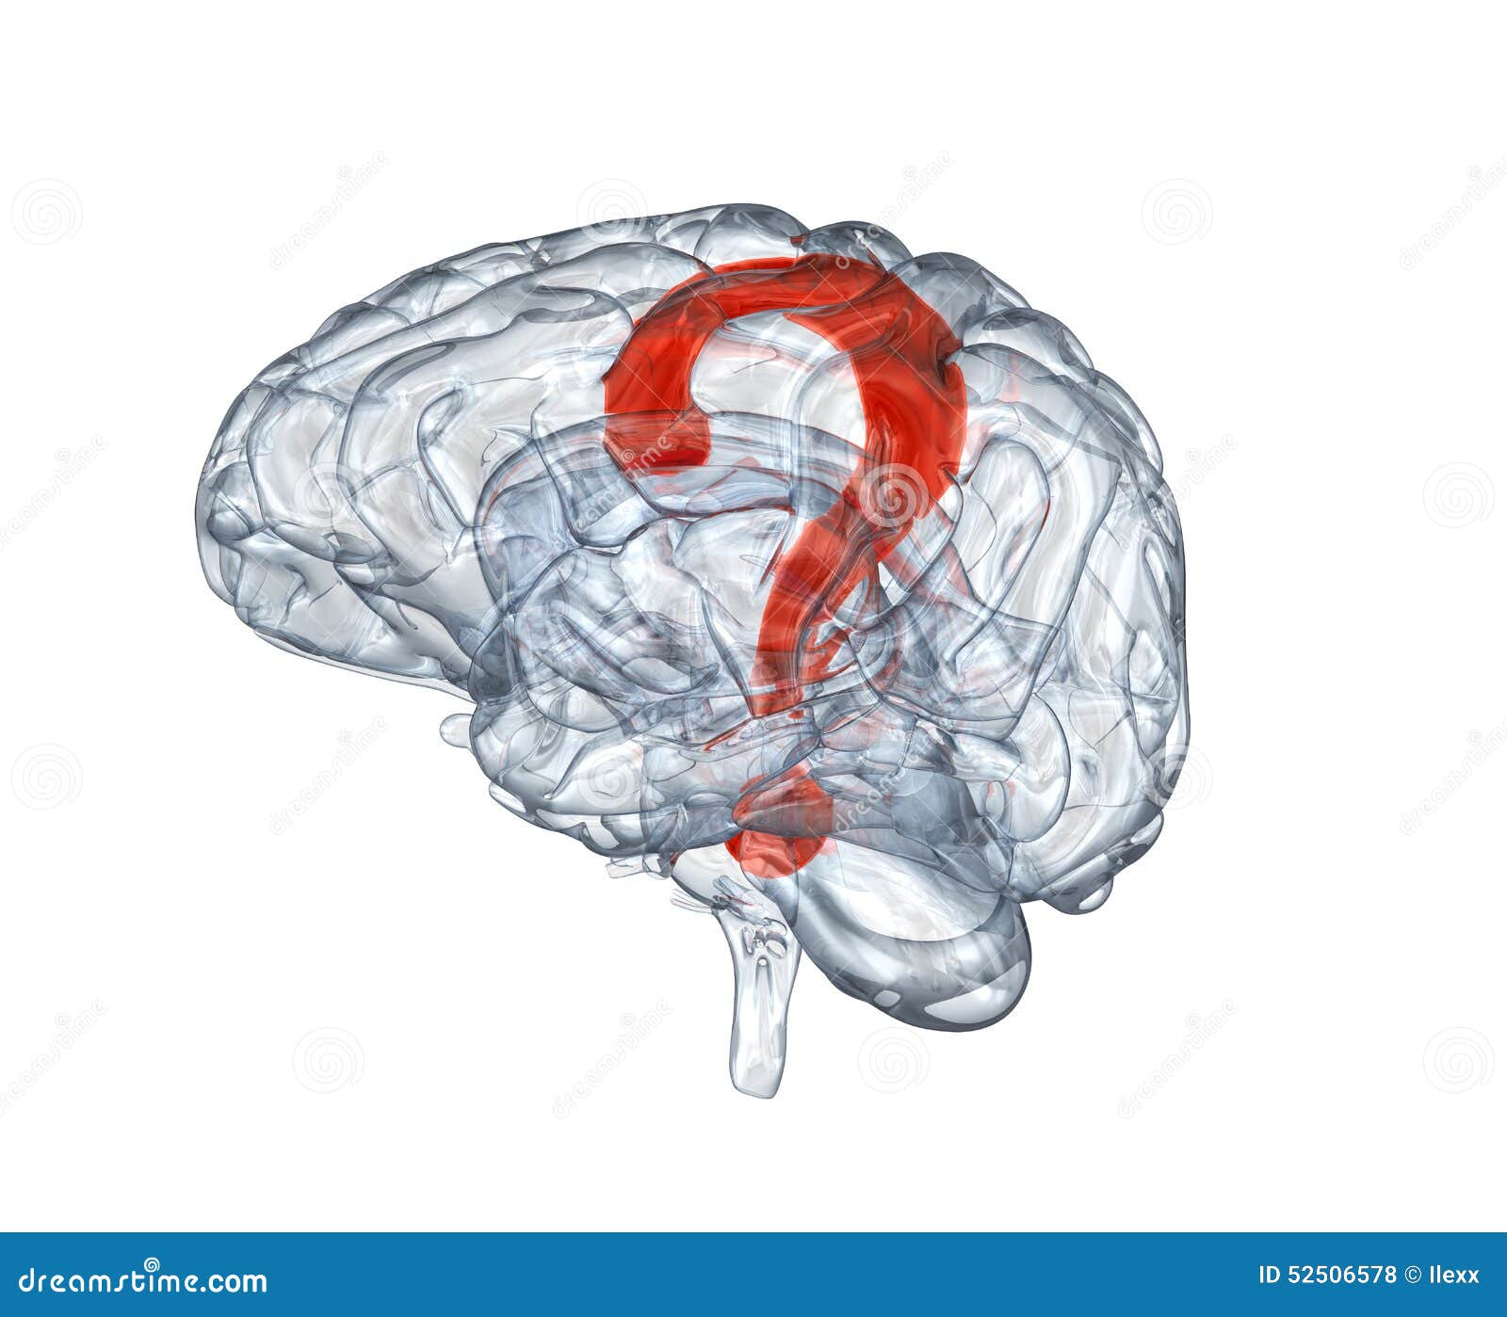
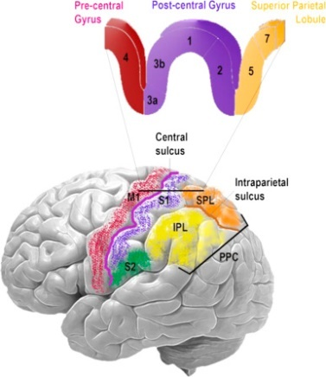
Two explanations of the phenomenon might be possible for the lost of grasp force signals
The grasp force information is preserved in other brain regions during the transportation
Somatosensory feedback is necessary to the grasp force during the transportation (cutaneomotor integration)
Notes:
So, the question here is: What possibility are there that the grasp force signals get lost during transportation in the previous experiment?
1. The information during transportation is preserved somewhere else (not in M1 but some other brain areas) during the transportation.
2. There was no somatosensory feedback, which might be necessary to the grasp force. In the previous experiment, due to the usage of the virtual arm, there is no sensory feedback to the participant. As the result of a phenomenon called cutaneomotor integration, which means that the S1 and the M1 are mutually influential, this can lead to the failure in generation of grasp force signals in the M1.
In our current research, since our subject only has electrode arrays in the S1 and M1, we cannot test the first hypothesis. So, we will explore the second hypothesis to see if the grasp force information exists in the M1 when there is somatosensory feedback.

Slide 7
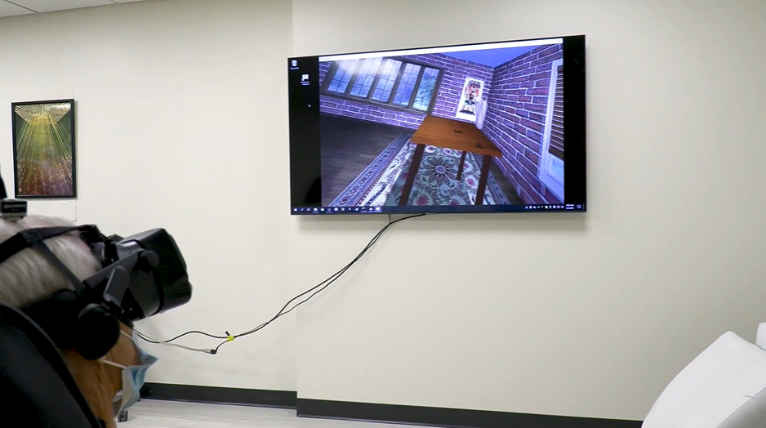
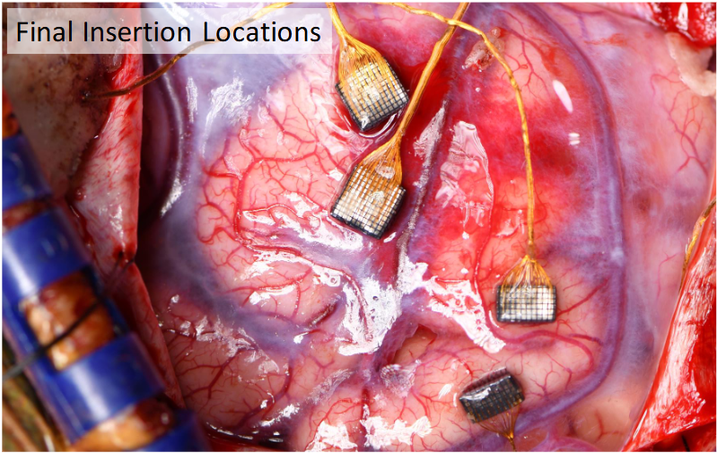
Our participant BCI02 can move his limbs and has residual somatosensory feedback, making tasks involving real arm and hand movements possible
Electrode arrays implanted in the somatosensory cortex (S1) and motor cortex (M1)
Notes:
Our subject has electrode arrays implanted in his S1 and M1. What makes our research possible is that our participant, BCI02, is special: he can move his limbs even though he suffers from spinal cord injury. Thus, he is able to move objects around and perform real object transportation tasks. Also, he has residual somatosensory feedback. As a result, we can shift from virtual arm movement tasks in the previous experiment to real arm and hand movements.

Slide 8
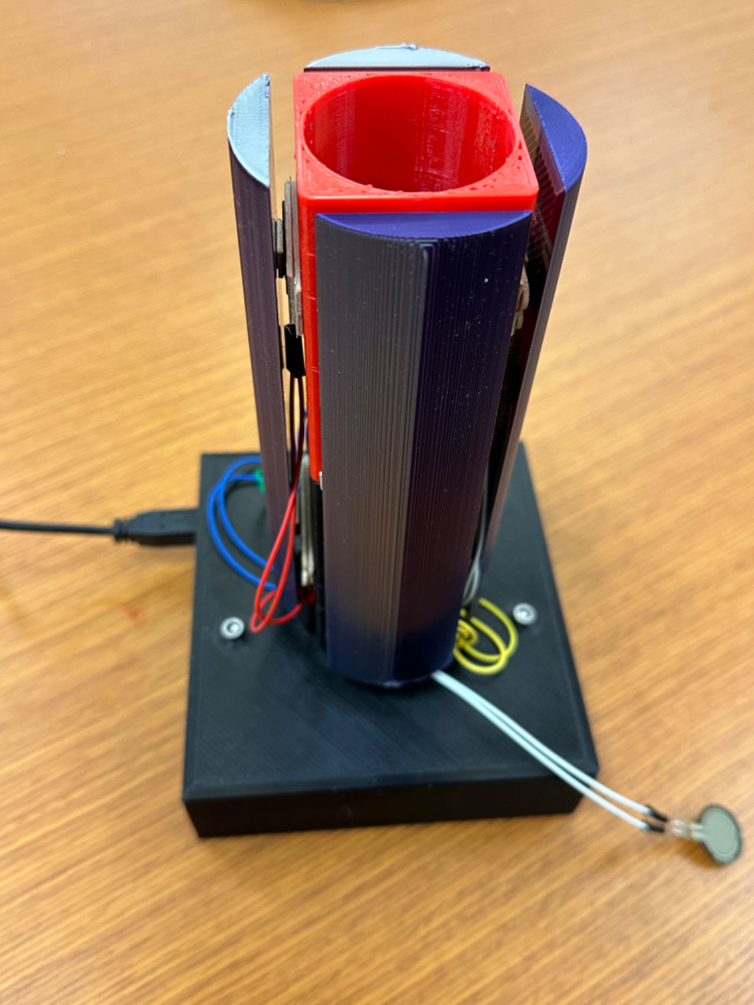
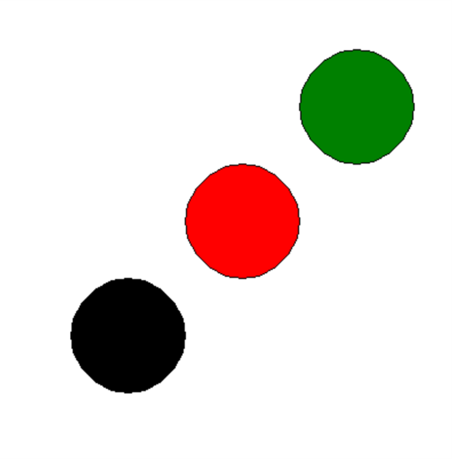
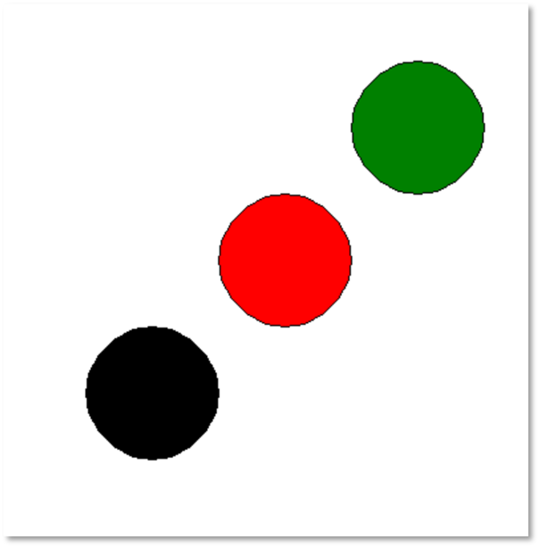
The subject grasps and moves the circular cylinder with FSRs from one projected dot to another, while the grasp force and brain signals are collected
Cylinder
Example Setting 1
Example Setting 2
Notes:
In the experiment, the subject is asked to move a circular cylinder that can be grasped in the palm around. Inside the surface of the cylinder, there are force sensing resistors to measure the grasp force applied to that area. Also, the weight of the cylinder is changed between trials to let the subject apply different levels of grasp force. The subject is shown multiple dots projected on a table in front of him sequentially, similar to the ones shown here, and he needs to move the cylinder from one dot to another. While the subject is performing the tasks, the brain signals from the M1 and S1 are collected.

Slide 9
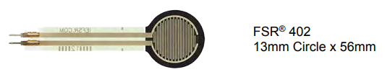
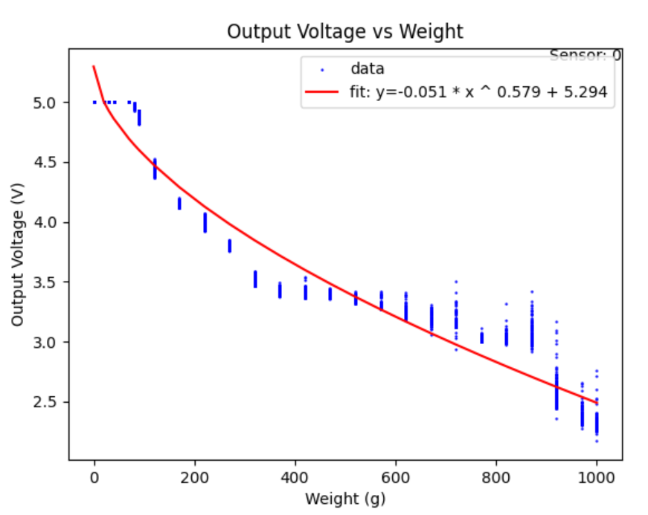
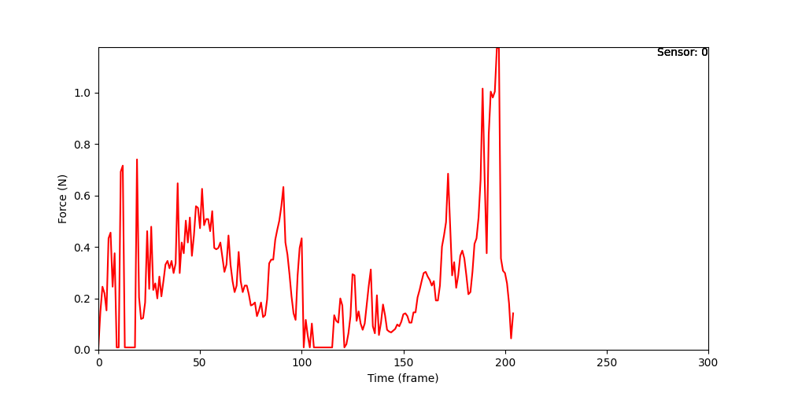

Our experiment utilizes force sensing resistors (FSRs) for force approximation
Apparatus Involved: Force Sensing Resistors (FSRs) on Arduino, FLIR BFS high speed camera, projector
Force calibration
Force approximation
5.0
1.0
4.5
$$a ∙x^{b}+c$$
0.8
4.0
Output voltage (V)
0.6
Force (N)
3.5
0.4
3.0
2.5
0.2
0.0
0
200
400
600
800
1000
0
50
100
150
200
250
300
Weight (g)
Time (frame)
Notes:
So how do we actually gather the data? We use Force Sensing Resistors (FSRs) on Arduino, a high speed camera for capturing the behaviors of the subject, and a projector for displaying patterns. The force sensing resistor can be used to measure the force after a calibration process. By putting different weights on the active area, we are able to construct an output voltage vs. weight scatterplot, from which we can use the indeterministic exponential function $a ∙e^{−b∙x}+c$ to approximate the data, which is shown on the right here.

Slide 10
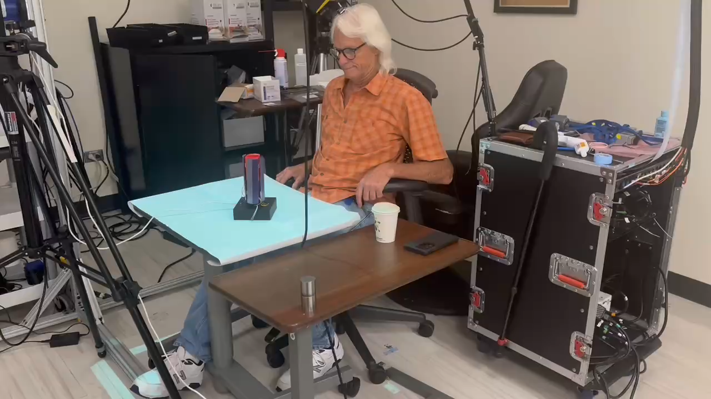
The subject grasps and moves the circular cylinder with FSRs from one projected dot to another, while the grasp force and brain signals are collected
Notes:
And this is a video (permission granted) showing the experiment in progress.

Slide 11

We are still in the process of data collecting and analysis
offline training of decoders
online (real-time) testing of decoders

Slide 12
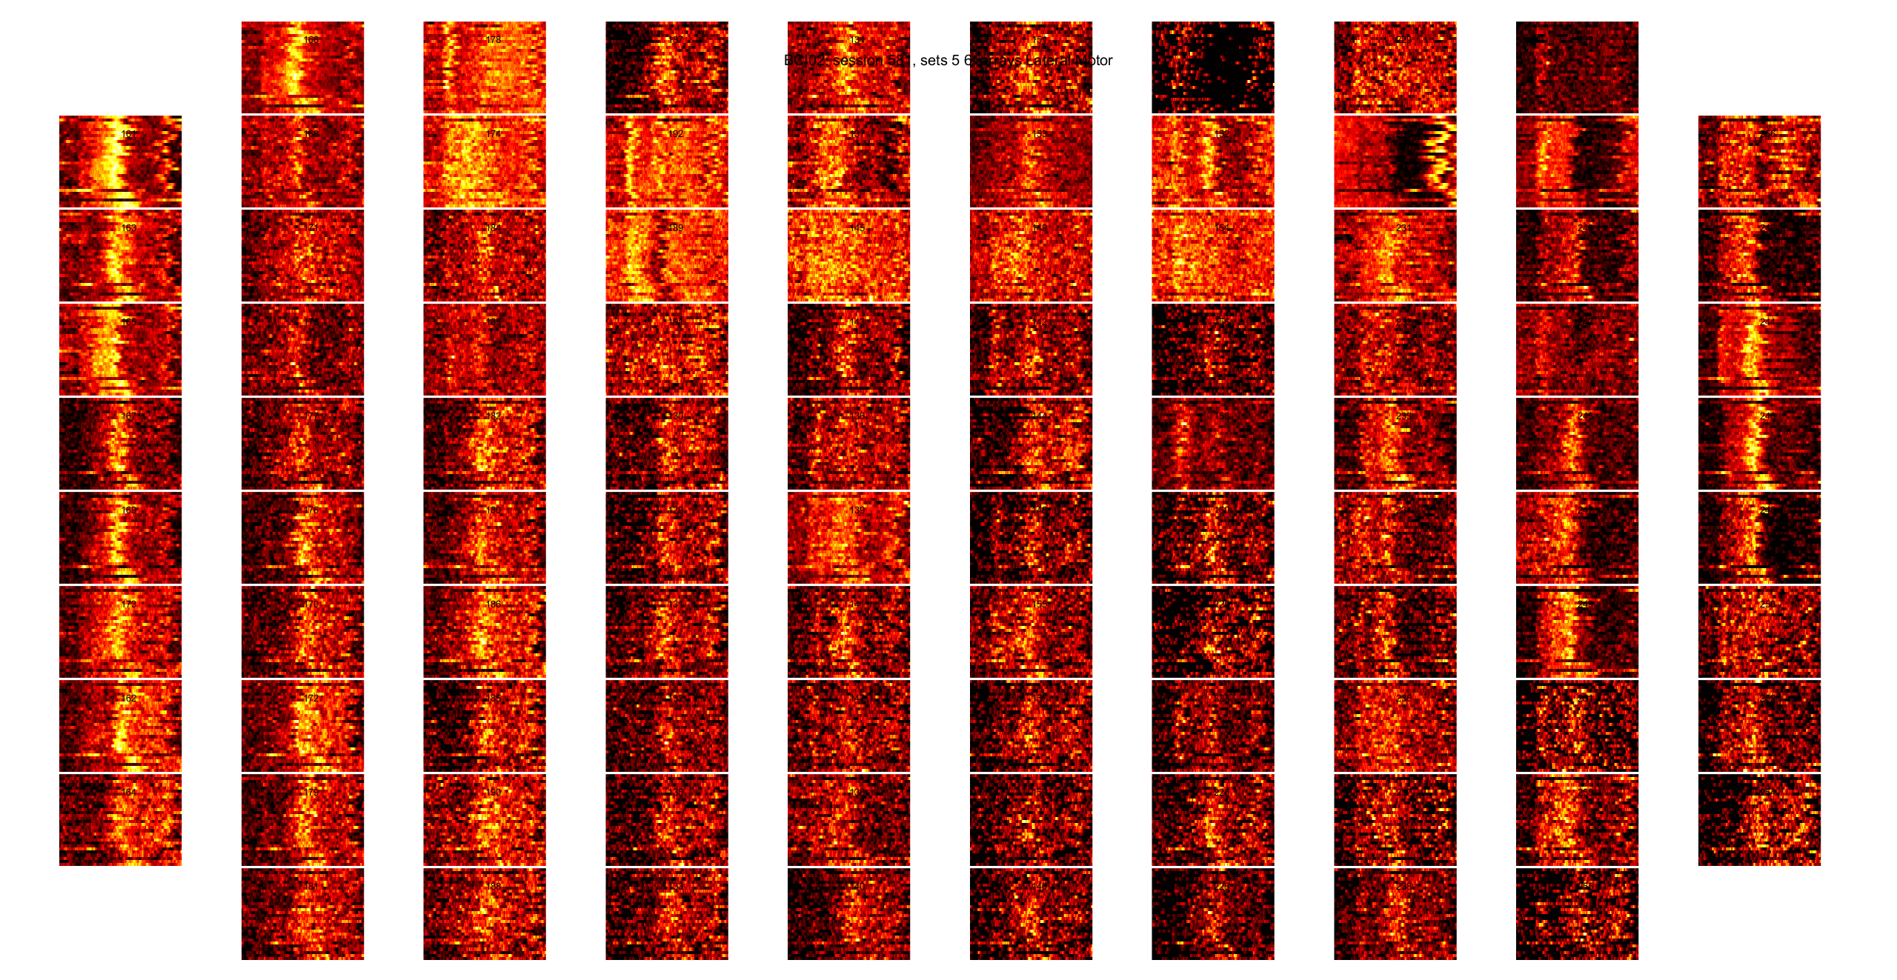
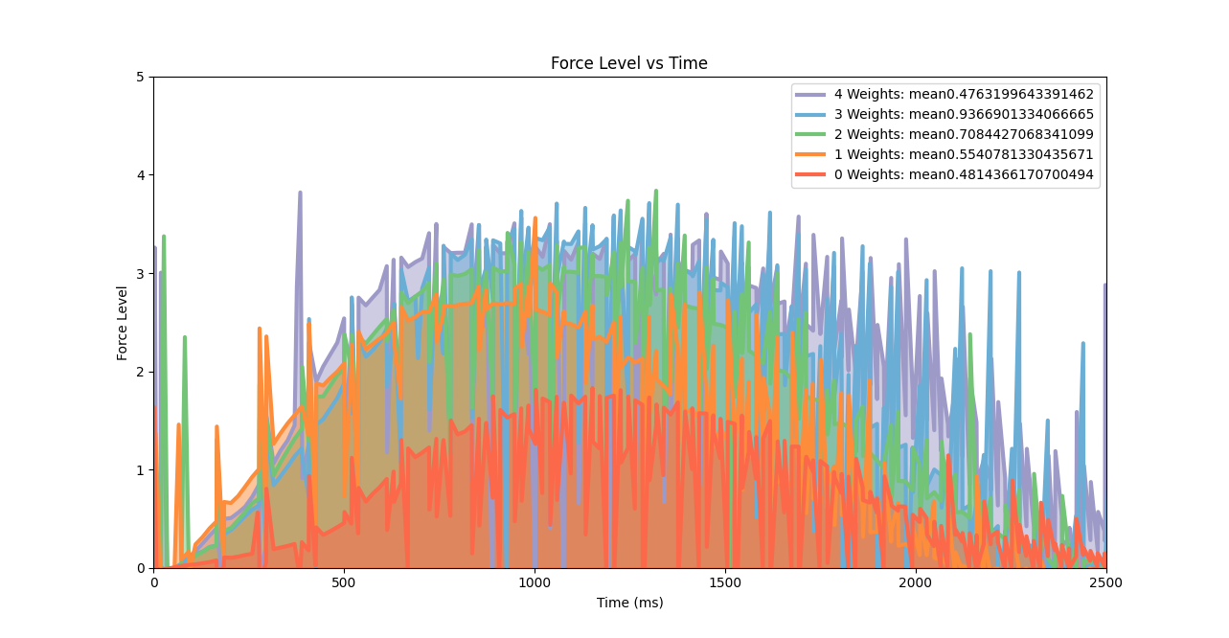
Preliminary data
Neural data from roughly 64 channels from the M1
50Hz grasp force data from 8 sensors
Analyze the relationship between grasp force and neural data. Then train decoders

Slide 13
Our future direction is online (real-time) testing of decoders
Same settings, same tasks
Use the real-time data from the electrodes to predict the grasp force
Compare the predicted grasp force with the real grasp force to see how effective the decoders are

Slide 14







Special Thanks
Nicholas Hatsopoulos
Anton Sobinov
Milan Rybář
Loren Wilkinson

